Slide 1


Human capital mediates natural selection in contemporary humans
David Hugh-Jones (University of East Anglia)
Abdel Abdellaoui (Amsterdam UMC)
Notes:
Move on!!

Slide 2
Contemporary humans are undergoing natural selection on polygenic scores (Barban et al. 2016; Beauchamp 2016; Kong et al. 2017; Sanjak et al. 2018).
But we have no theory of why.
We examine natural selection on 33 polygenic scores in UK Biobank.
Patterns in the data can be explained by the economic theory of fertility (Becker 1960).
Natural selection has substantial effects on genetic inequality (Harden 2021).

Slide 3
DNA
Human DNA has about 3 billion base pairs.
Each pair consists of two molecules of adenine (A), cytosine (C), guanine (G), and thymine (T). The pairs are A-T or C-G.
Most of these are identical across all humans, but we differ from each other at about 4-5 million sites.
One kind of variation is the Single Nucleotide Polymorphism (SNP): a difference at a single base pair. Humans may carry 0, 1 or 2 of the minor allele (the less common of the possible pairs).
DNA arrays capture SNP data at a large number of locations.

Slide 4
Polygenic scores
A polygenic score is a summary statistic derived from DNA.
It is a weighted sum of SNP alleles. Weights are derived from bivariate correlations with the target phenotype (e.g. years of education, coronary artery disease, age started smoking).
Only correlations below a given p-value threshold may be used, and weights may be adjusted for correlation among different SNPs.

Slide 5
We create 33 polygenic scores for individuals in UK Biobank.
Summary statistics (weights) for the polygenic scores were calculated excluding any data from UK Biobank.
Scores are normalized to mean 0, variance 1.
To estimate natural selection, we calculate bivariate correlations with fertility.
Scores which correlate positively (negatively) with fertility are being selected for (against).
The correlation equals the expected polygenic score in the children’s generation.
Note: no claim about causality here!

Slide 6
Sample
UK Biobank: a health survey comprising about 500,000 individuals, born 1934-1970.
Respondents are selected geographically (22 assessment centres around Great Britain); and by health, income, etc. due to different response rates.
Includes DNA data, health questionnaire and some “social science” variables.
We use:
Number of children
Number of siblings (to estimate natural selection in the previous generation)
For number of children we use individuals aged 45+.

Slide 7
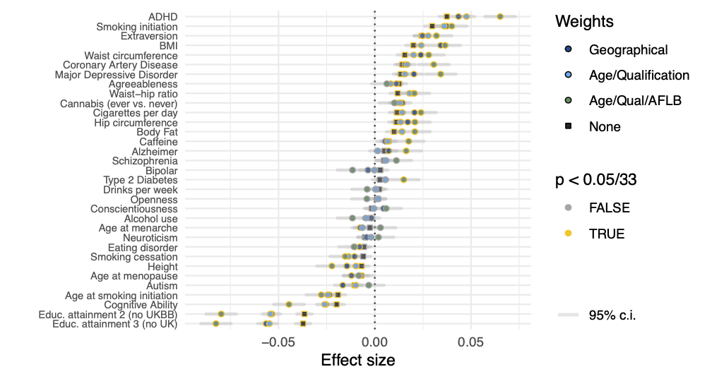
Correlations with completed fertility
Notes:
Each row here is one polygenic score. Plots are bivariate correlations with completed fertility. Scores with positive correlations (e.g ADHD, BMI) are being selected for. Scores with negative correlations are being selected against.
We adjust p values to correct for 33 comparisons (within each weighting).
UKBB has ascertainment bias. When we correct for this, effect sizes are larger.

Slide 8
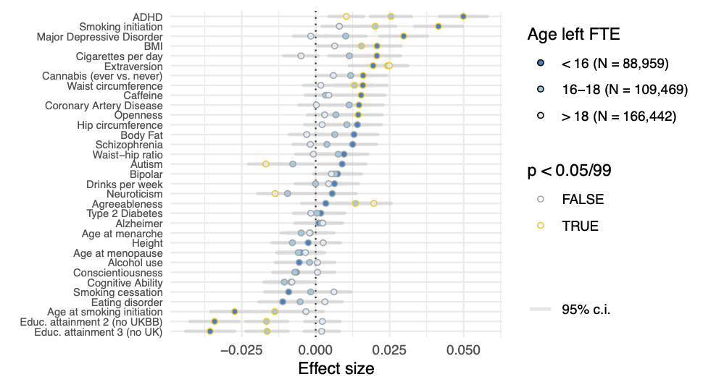
Education
Notes:
We split our sample into subgroups. Here we’ve split by age leaving full time education. Effects are larger and more significant for those leaving education early.

Slide 9
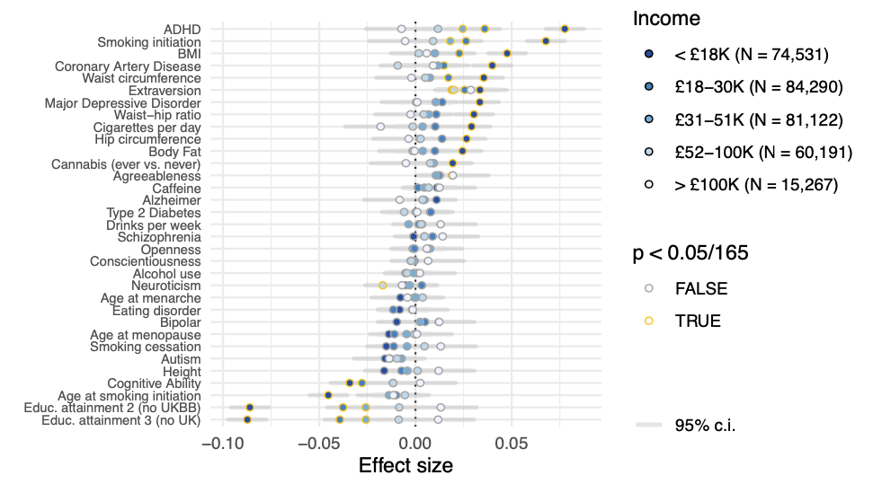
Income
Notes:
Effects are larger among low-income households.

Slide 10
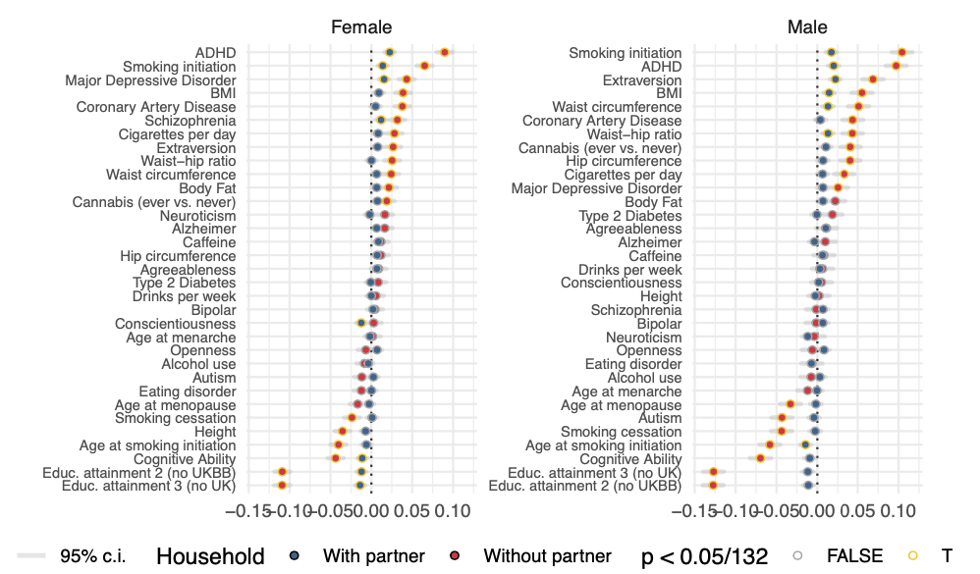
Household structure
Notes:
Effects are larger for people not living with a partner.

Slide 11
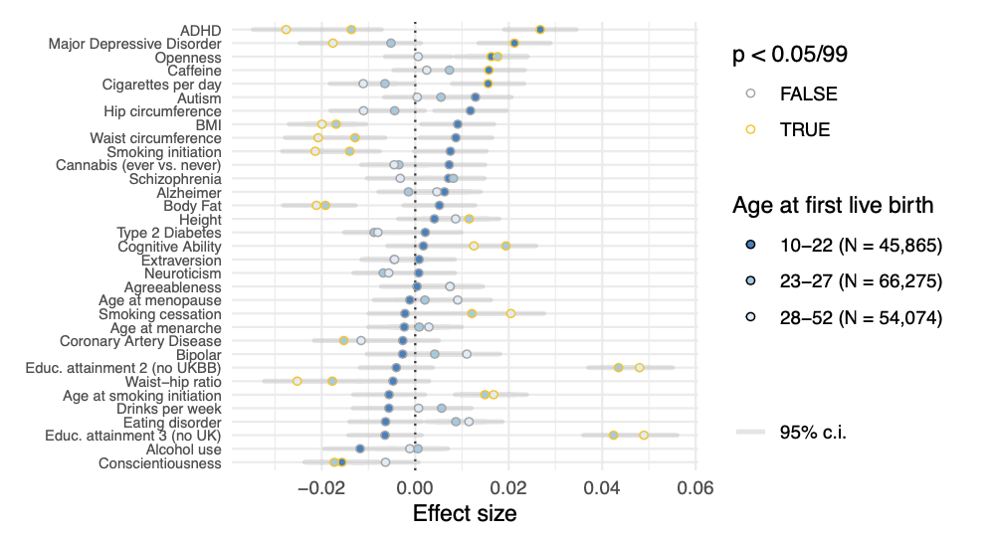
Age at first birth (women)
Notes:
Effect sizes are actually reversed among older mothers.
One caveat: these categories are not exogenous to polygenic scores. For example, a PGS may affect fertility condition on age at first live birth, but also may affect your age at first live birth. Nevertheless, these patterns need explanation.

Slide 12
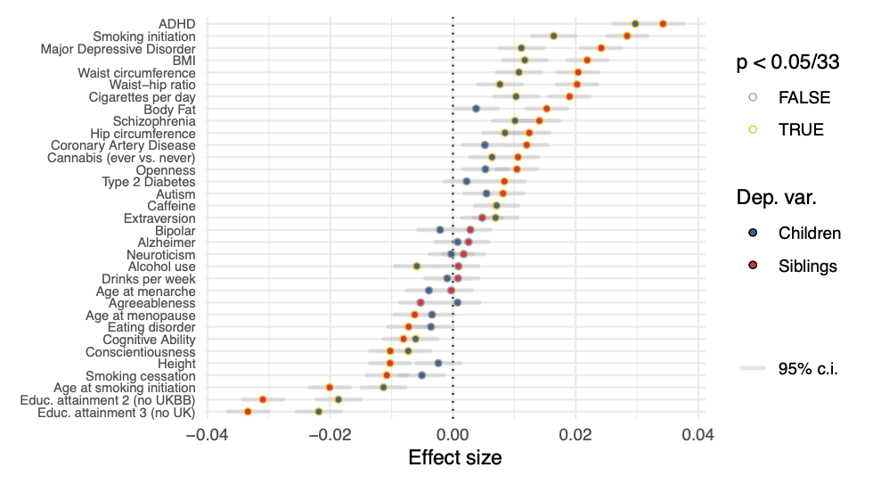
Parents’ generation (dep. var.: N siblings)
Notes:
Weighted by inverse of number of siblings to correct for selection bias.

Slide 13
Is there change over time?
Comparing siblings to children regressions is hard:
Parents with 0 children can’t be parents of anyone in the sample.
Effects of childlessness on estimates may vary across generations.
Instead, we median-split the sample at YOB 1950, and compare effect sizes among these groups.
We find little evidence for change in effect sizes.

Slide 14
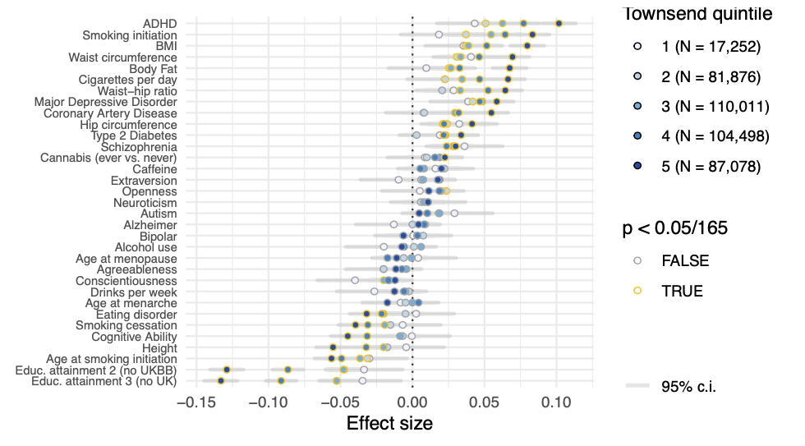
Townsend deprivation quintile, parents’ generation

Slide 15
Model
By increasing a person’s expected wage, human capital has opposing effects on fertility (Becker 1960):
Children become more affordable (income effect)…
… but cost more in foregone wages (substitution effect)
We write down a simple model of human capital and fertility choice.
Notes:
Gary Becker argued that, by increasing a person’s wage, human capital has two opposing effects on fertility: children become more affordable, but they cost more in foregone wages. We write down a simple model of human capital and fertility choice, and it explains the patterns I’ve just shown you.

Slide 16

Model
Utility is given by
𝑈(𝑁1, 𝑁2) = 𝑢(𝑌1) + 𝑢(𝑌2) + 𝑎𝑁1 + 𝑎𝑁2
Where
N1, N2 are the number of children in each period;
Y1, Y2 is income in each period.
Period 1 wages are 1.
In period 1, individuals choose a level of education at time cost s. Period 2 wages are w(s,h) = sh where h is exogenous human capital.
Raising a child takes time b.
Utility over income is CRRA:
$$u\left(y\right)=\frac{y^{1−σ}−1}{σ−1}$$

Slide 17
Results
For 𝜎 < 1 and close enough to 1, the fertility-human capital relationship dN*/dh is:
Negative.
Closer to zero at higher wages and/or levels of human capital. Weaker effects on fertility at higher income.
Closer to zero at higher levels of education s. Weaker effects at higher education levels.
More negative when the time burden of children b is larger. Stronger effects among those living without a partner.
Closer to zero among those who start fertility in period 2 (N*1 = 0) than among those who start fertility in period 1 (N*1 > 0). Weaker effects for later age at first birth.

Slide 18
Results
For 𝜎 < 1 and close enough to 1, the fertility-human capital relationship dN*/dh is:
Negative.
Closer to zero at higher wages and/or levels of human capital. Weaker effects on fertility at higher income.
Closer to zero at higher levels of education s. Weaker effects at higher education levels.
More negative when the time burden of children b is larger. Stronger effects among those living without a partner.
Closer to zero among those who start fertility in period 2 (N*1 = 0) than among those who start fertility in period 1 (N*1 > 0). Weaker effects for later age at first birth.

Slide 19
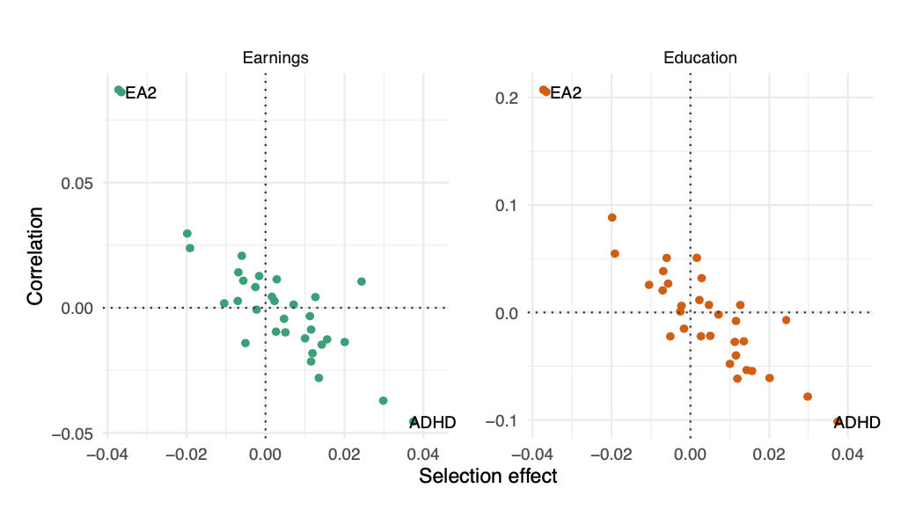
PGS which correlate negatively with earnings and education are selected for
Notes:
To test this theory we correlate our polygenic scores with earnings. Scores which correlate negatively with earnings and education are selected for. Those which correlate positively with earnings and education are selected against.

Slide 20
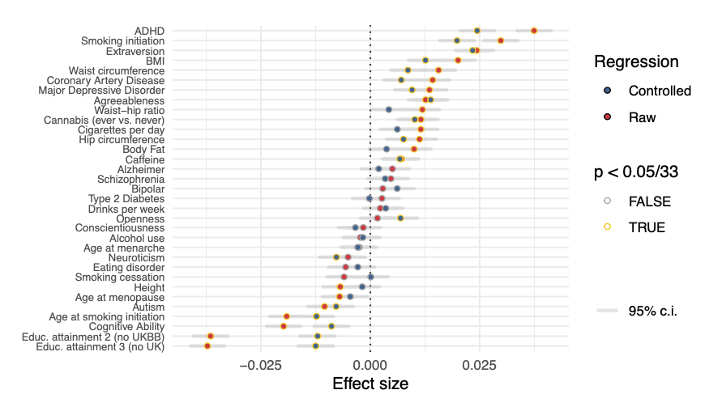
Controlling for earnings and education

Slide 21
Within-siblings regressions
Within siblings, genetic variation is assigned randomly.
We can use this to test for causal effects of genes on fertility among ~ 36,000 individuals in a sibling group.
No results are significant after Bonferroni correction.
Results correlate with pooled effect sizes, and are about 1/3 smaller (regression of within-sibling on pooled, b = 0.71).
Controlling for earnings and education has little effect, though educational attainment effect size is reduced by ~ 20%.

Slide 22
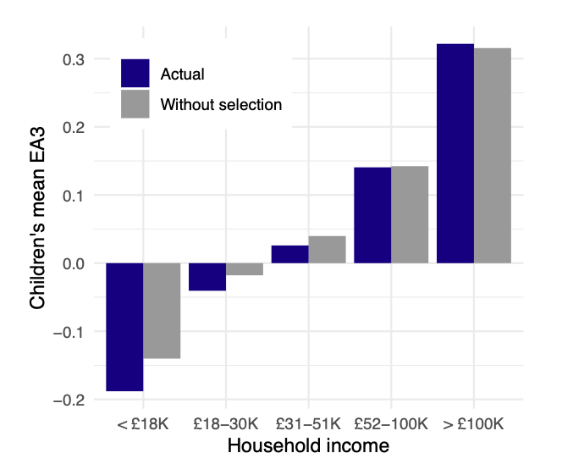
Effects
Effects on population means are small.
But noisy PGS imply errors-in-variables.
And sample selection in UKBB seems to bias results towards 0.
Effects on inequality are substantive.
Results increase inequality for 29 out of 33 scores.
Median increase in difference between highest- and lowest-income groups: 14% in 1 generation.
Notes:
Because correlations with fertility are larger in low income groups, they increase the genetics-SES gradient. The median polygenic score’s difference between highest and lowest income groups increases by 14% over 1 generation.
If genetics matters for explaining differences across economic groups, then these changes are substantial.

Slide 23
SAPERE AUDE
Thank you!

